Slide 1
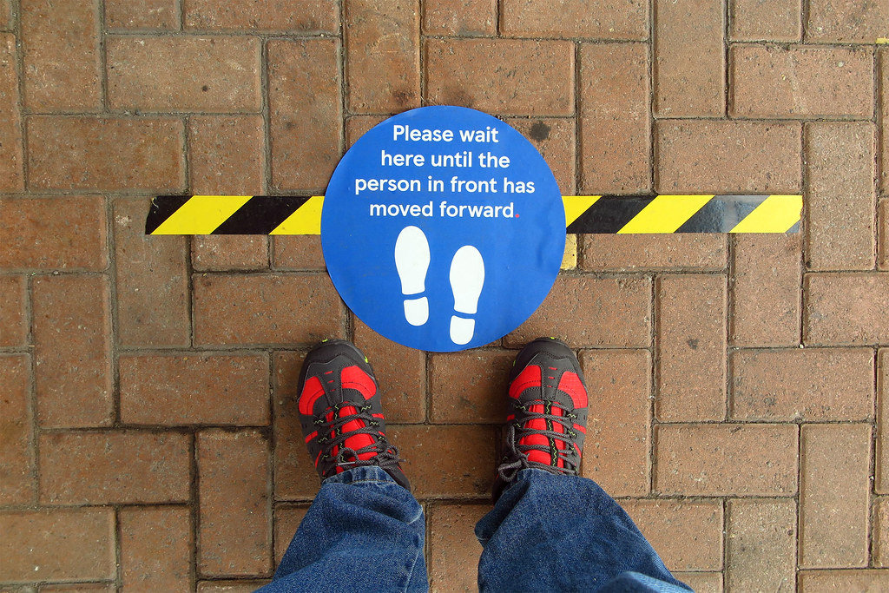
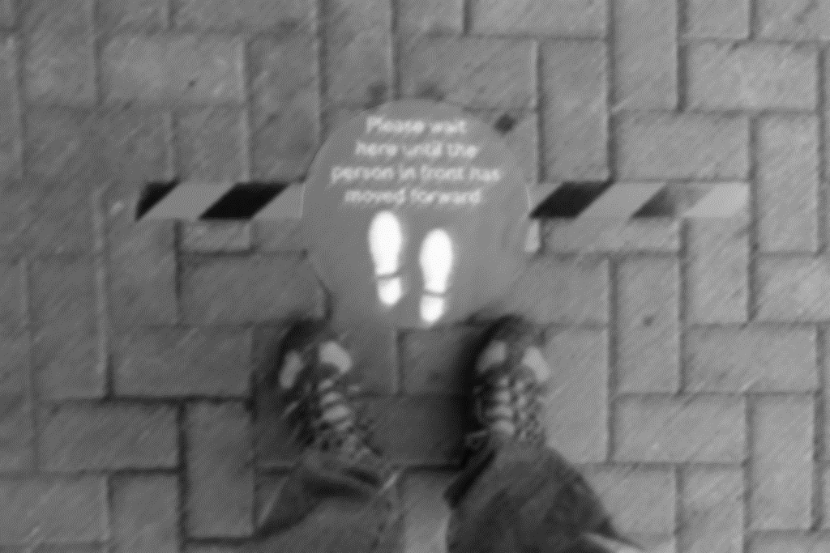
Delivered from the fear of Death
Hebrews 2:14-18

Slide 2
Delivered from the fear of Death
Hebrews 2:14-18
“We doctors are scared of the coronavirus crisis. How could we not be?”

Slide 3
Delivered from the fear of Death
Hebrews 2:14-18
“We doctors are scared of the coronavirus crisis. How could we not be?”
Many questions about Covid-19!

Slide 4
Delivered from the fear of Death
Hebrews 2:14-18
“We doctors are scared of the coronavirus crisis. How could we not be?”
Many questions about Covid-19!
What is God’s answer?

Slide 5
Delivered from the fear of Death
Hebrews 2:14-18
“Since the children have flesh and blood, he too shared in their humanity so that by his death he might break the power of him who holds the power of death – that is, the devil – and free those who all their lives were held in slavery by their fear of death. For surely it is not angels he helps, but Abraham’s descendants. For this reason he had to be made like them fully human in every way, in order that he might become a merciful and faithful high priest in service to God, and that he might make atonement for the sins of the people. Because he himself suffered when he was tempted, he is able to help those who are being temped” (Heb.2:14-18 NIV).

Slide 6
Delivered from the fear of Death
Hebrews 2:14-18
1. Deliverance is necessary

Slide 7
Delivered from the fear of Death
Hebrews 2:14-18
1. Deliverance is necessary
Afraid of accountability

Slide 8
Delivered from the fear of Death
Hebrews 2:14-18
1. Deliverance is necessary
Afraid of accountability
All have “moral compass”!

Slide 9
Delivered from the fear of Death
Hebrews 2:14-18
Deliverance is necessary
Deliverance accomplished!
“Since the children have flesh and blood, he too shared in their humanity so that by his death he might break the power of him who holds the power of death – that is, the devil”

Slide 10
Delivered from the fear of Death
Hebrews 2:14-18
Deliverance is necessary
Deliverance accomplished!
“Since the children have flesh and blood, he too shared in their humanity so that by his death he might break the power of him who holds the power of death – that is, the devil”

Slide 11
Delivered from the fear of Death
Hebrews 2:14-18
Deliverance is necessary
Deliverance accomplished!
“Since the children have flesh and blood, he too shared in their humanity so that by his death he might break the power of him who holds the power of death – that is, the devil”

Slide 12
Delivered from the fear of Death
Hebrews 2:14-18
Deliverance is necessary
Deliverance accomplished!
“Since the children have flesh and blood, he too shared in their humanity so that by his death he might break the power of him who holds the power of death – that is, the devil”

Slide 13
Delivered from the fear of Death
Hebrews 2:14-18
Deliverance is necessary
Deliverance accomplished!
“Since the children have flesh and blood, he too shared in their humanity so that by his death he might break the power of him who holds the power of death – that is, the devil –
and free those who all their lives were held in slavery by their fear of death.”

Slide 14
Delivered from the fear of Death
Hebrews 2:14-18
Deliverance is necessary
Deliverance accomplished!
Power is given from above

Slide 15
Delivered from the fear of Death
Hebrews 2:14-18
Deliverance is necessary
Deliverance accomplished!
Deliverance continues

Slide 16
Delivered from the fear of Death
Hebrews 2:14-18
Deliverance is necessary
Deliverance accomplished!
Deliverance continues
Fear paralyses

Slide 17
Delivered from the fear of Death
Hebrews 2:14-18
Deliverance is necessary
Deliverance accomplished!
Deliverance continues
Fear paralyses
there is no fear in love!

Slide 18
Delivered from the fear of Death
Hebrews 2:14-18
Deliverance is necessary
Deliverance accomplished!
Deliverance continues
Fear paralyses
God is merciful
there is no fear in love!

Slide 19
Delivered from the fear of Death
Hebrews 2:14-18
Deliverance is necessary
Deliverance accomplished!
Deliverance continues
Fear paralyses
God is merciful
God is faithful
there is no fear in love!

Slide 20
Delivered from the fear of Death
Hebrews 2:14-18
Deliverance is necessary
Deliverance accomplished!
Deliverance continues
Fear paralyses
God is merciful
God is faithful
Jesus shares our sufferings
there is no fear in love!

Slide 21
Delivered from the fear of Death
Hebrews 2:14-18
Deliverance is necessary
Deliverance accomplished!
Deliverance continues
Fear paralyses
God is merciful
God is faithful
Jesus shares our sufferings
Jesus supplies our strength
there is no fear in love!

Slide 22
Delivered from the fear of Death
Hebrews 2:14-18
Deliverance is necessary
Deliverance accomplished!
Deliverance continues
Fear paralyses
God is merciful
God is faithful
Jesus shares our sufferings
Jesus supplies his strength
Afraid of dying? Jesus accompanies us.
there is no fear in love!

